Slide 1
2
The Management
Environment
Copyright ©2017 Pearson Education, Inc.
2-<number>

Slide 2
Learning Outcomes
Explain what the external environment is and why it’s important.
Discuss how the external environment affects managers.
Define what organizational culture is and why it’s important.
Describe how organizational culture affects managers.
Copyright ©2017 Pearson Education, Inc.
2-<number>
Notes:
After studying this chapter, you will be able to:
Explain what the external environment is and why it’s important.
Discuss how the external environment affects managers.
Define what organizational culture is and explain why it’s important.
Describe how organizational culture affects managers.

Slide 3
2-1
Explain what the external environment is and why it’s important.
Copyright ©2017 Pearson Education, Inc.
2-<number>

Slide 4
External Environment
  Factors, forces, situations, and events outside the organization that affect its performance.
Copyright ©2017 Pearson Education, Inc.
2-<number>
Notes:
One of the biggest mistakes managers make today is failing to adapt to the changing world. No successful organization, or its managers, can operate without understanding and dealing with the dynamic environment—external and internal—that surrounds it.
The term external environment refers to factors, forces, situations, and events outside the organization that affect its performance.
For example, a volcanic eruption in Iceland in 2010 prevented delivery of auto parts that led to a shutdown at a BMW plant in South Carolina and a Nissan Motors facility in Japan.

Slide 5
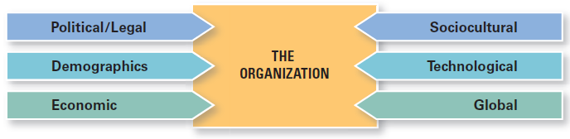
Components of the
External Environment
Copyright ©2017 Pearson Education, Inc.
2-<number>
Notes:
As shown here in Exhibit 2-1, the external environment includes six components:
The economic component encompasses factors such as interest rates, inflation, changes in disposable income, stock market fluctuations, and business cycle stages.
The demographic component includes trends in population characteristics such as age, race, gender, education level, geographic location, income, and family composition.
The technological component focuses on scientific and industrial innovations.
The sociocultural component is concerned with societal and cultural factors such as values, attitudes, trends, traditions, lifestyles, beliefs, tastes, and patterns of behavior.
The political/legal component looks at federal, state, and local laws, as well as other countries’ laws and global laws. It also includes a country’s political conditions and stability.
The global component encompasses issues associated with globalization and a world economy.

Slide 6
What Is the Economy
Like Today?
  Global productivity still slow
  Global trade is sluggish
  U.S. employment is up
  Is the American dream still a possibility?
Copyright ©2017 Pearson Education, Inc.
2-<number>
Notes:
The economic crisis that gripped the United States and other countries in 2008 appears to finally be over, though growth and productivity in Europe is still behind that of the United States. Global trade is also sluggish, prompting some analysts to ask whether the world is becoming less connected.
With an unemployment rate of just 5.5 percent, U.S. employment is up, but much of that is related to low-wage jobs. Further complicating the picture is the fact that some seven million Americans are trapped in part-time jobs, unable to find full-time positions. Moreover, just 64 percent of Americans still believe that the so-called American dream that hard work leads to success and riches is real.

Slide 7
Economic Inequality
Harris Interactive Poll:
Only 10 percent of adults think economic inequality is “not a problem at all.”
Copyright ©2017 Pearson Education, Inc.
2-<number>
Notes:
Most survey respondents believed that it is either a major problem (57 percent) or a minor problem (23 percent). Why has this issue become so sensitive? Those who worked hard and were rewarded because of their hard work or creativity have long been admired. In the United States, that gap between the rich and the rest has been much wider than in other developed nations for decades and was accepted as part of our country’s values and way of doing things.
As economic growth has languished and sputtered, and as people’s belief that anyone could grab hold of an opportunity and have a decent shot at prosperity has wavered, social discontent over growing income gaps has increased. The bottom line is that business leaders need to recognize how societal attitudes in the economic context may also create constraints as they make decisions and manage their businesses.

Slide 8
The Sharing Economy
Asset owners share with other individuals through peer-to-peer service, for a set fee, their underutilized physical assets or their knowledge, expertise, skills, or time.
Copyright ©2017 Pearson Education, Inc.
2-<number>
Notes:
Airbnb, Uber, Zipcar, and SnapGoods are just a few examples of a fast-growing phenomenon called the sharing economy, in which asset owners share with other individuals through peer-to-peer service, for a set fee, their underutilized physical assets or their knowledge, expertise, skills, or time.

Slide 9
Demographics
Demography is destiny.
Age Cohorts
  Baby Boomers
  Gen X
  Gen Y
  Gen Z
Copyright ©2017 Pearson Education, Inc.
2-<number>
Notes:
Demographics refers to the characteristics of a population used for purposes of social studies. It has a significant impact on how managers manage and include such factors as age, income, sex, race, education level, ethnic makeup, employment status, geographic location, and more.
Age is a particularly important demographic for managers because the workplace often encompasses different age groups.
Baby Boomers are those individuals born between 1946 and 1964. The sheer number of people in that cohort means they’ve had a significant impact on every aspect of the external environment (from the educational system to entertainment/lifestyle choices to the Social Security system and so forth) as they’ve gone through various life cycle stages.
Gen X is used to describe those individuals born between 1965 and 1977. It followed the baby boom and is one of the smaller age cohorts.
Gen Y (or the “Millennials”) encompasses those individuals born between 1978 and 1994. From technology to clothing styles to work attitudes, Gen Y is impacting organizational workplaces.
Then, there is Gen Z—the youngest identified age group, basically teens and middle-schoolers. This group has always been digitally connected – their primary means of social interaction is online.
Demographic age cohorts are important to our study of management because large numbers of people at certain stages in the life cycle can constrain decisions and actions taken by businesses, governments, educational institutions, and other organizations.
Studying demographics involves looking at current statistics and future trends. For instance, recent analysis of birth rates shows that more than 80 percent of babies being born worldwide are from Africa and Asia. And here’s an interesting fact: India has one of the world’s youngest populations – by 2020, the median age will be 29. And by 2050, it’s predicted that China will have more people age 65 and older than the rest of the world combined.

Slide 10
2-2
Discuss how the external environment affects managers.
Copyright ©2017 Pearson Education, Inc.
2-<number>

Slide 11
How Does External Environment Affect Managers?
  Jobs and employment
  Assessing environmental uncertainty
  Managing stakeholder relationships
Copyright ©2017 Pearson Education, Inc.
2-<number>
Notes:
There are three ways that the external environment affects managers:
Its impact on jobs and employment.
The amount of environmental uncertainty.
The nature of stakeholder relationships.
As external environmental conditions change, managers face the impact of these changes on jobs and employment. Economists predict that about one quarter of the 8.4 million U.S. jobs eliminated during the most recent economic downturn won’t be reinstated.
Such readjustments create challenges for managers who must balance work demands with having enough people with the right skills to do the organization’s work.
Changes in external conditions not only affect the types of jobs available but they also affect how the jobs are created and managed. For example, many employers use flexible work arrangements and contract freelancers or temporary workers.

Slide 12
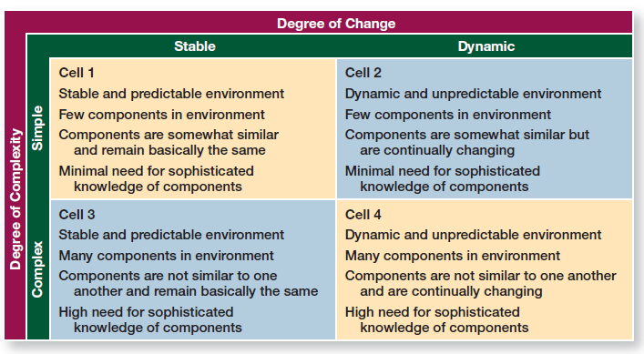
Assessing Environmental Uncertainty
Copyright ©2017 Pearson Education, Inc.
2-<number>
Notes:
Another constraint posed by external environments is the amount of uncertainty that exists, which can affect organizational outcomes. Environmental uncertainty refers to the degree of change and complexity in an organization’s environment. This matrix shows these two aspects.
The first dimension of uncertainty is the degree of unpredictable change; that is, a stable environment experiences minimal change and a dynamic environment experiences frequent change. For example, a stable environment might have no new competitors, few technological breakthroughs by current competitors, little pressure from groups trying to influence the organization, and so on.
The other dimension of uncertainty describes the degree of environmental complexity, which looks at the number of components in an organization’s environment and the knowledge that the organization has about those components.
Therefore, an organization with few competitors, customers, suppliers, or government agencies to deal with, or an organization that needs little information about its environment, has a less complex and more certain, stable environment, as seen in Cell 1.
So how does the concept of environmental uncertainty influence managers? As illustrated here, each of the four cells represents different combinations of degree of complexity and degree of change.
Cell 1 (a stable-simple environment) represents the lowest level of environmental uncertainty and Cell 4 (a dynamic and complex environment) represents the highest level of environmental uncertainty.
Not surprisingly, managers have the greatest influence on organizational outcomes in Cell 1 and the least influence in Cell 4.
Because uncertainty is a threat to an organization’s effectiveness, managers try to minimize it.
Most industries today face more dynamic change, and consequently, their environments are more uncertain.

Slide 13
Managing Stakeholder Relationships
Stakeholders:
any constituencies in an organization’s environment that are affected by that organization’s decisions and actions.
Copyright ©2017 Pearson Education, Inc.
2-<number>
Notes:
The nature of stakeholder relationships is another way in which the environment influences managers. The more obvious and secure these relationships, the more influence managers will have over organizational outcomes.
Stakeholders are any constituencies in an organization’s environment that are affected by that organization’s decisions and actions. These groups have a stake in, or are significantly influenced by, what the organization does. In turn, these groups can influence the organization.
For example, think of the groups that might be affected by the decisions and actions of Starbucks—coffee bean farmers, employees, specialty coffee competitors, local communities, and so forth. Some of these stakeholders also, in turn, may impact decisions and actions of Starbucks’ managers.

Slide 14
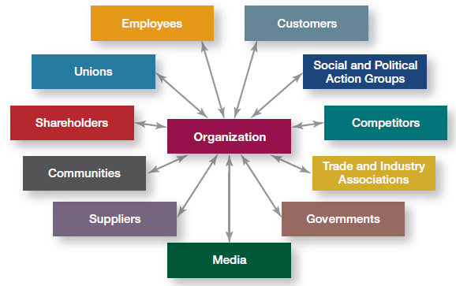
Organizational Stakeholders
Copyright ©2017 Pearson Education, Inc.
2-<number>
Notes:
Here in Exhibit 2-3, we see the most common stakeholders in an organization.
Note that these stakeholders include both internal and external groups because both groups can affect what an organization does and how it operates.
Managers benefit from good management of stakeholder relationships because stronger relationships can improve the predictability of environmental changes, lead to more successful innovations, foster a greater degree of trust among stakeholders, and increase organizational flexibility to reduce the impact of change.

Slide 15
Good Stakeholder Relationships:
Can lead to desirable organizational outcomes
Can affect organizational performance
Demonstrate doing the “right” thing
Copyright ©2017 Pearson Education, Inc.
2-<number>
Notes:
Good stakeholder relationships can lead to desirable organizational outcomes such as improved predictability of environmental changes, more successful innovations, greater degree of trust among stakeholders, and greater organizational flexibility to reduce the impact of change.
Stakeholder management can affect organizational performance. Management researchers who have looked at this issue are finding that managers of high performing companies tend to consider the interests of all major stakeholder groups as they make decisions.
Another reason for managing external stakeholder relationships is that it’s the “right” thing to do. Because an organization depends on these external groups as sources of inputs (resources) and as outlets for outputs (goods and services), managers should consider the interests of stakeholders as they make decisions. We’ll address this issue in more detail in the next chapter when we look at corporate social responsibility.

Slide 16
2-3
Define what organizational culture is and explain why it’s important.
Copyright ©2017 Pearson Education, Inc.
2-<number>

Slide 17

What is Organizational Culture?
Copyright ©2017 Pearson Education, Inc.
2-<number>
Notes:
Each of us has a unique personality that influences the way we act and interact. An organization has a personality too—we call it CULTURE.
Google has created a creative and innovative culture at their headquarters in California with an android googleplex, bikes, and bringing your dog to work.

Slide 18
Organizational Culture
Shared values, principles, traditions,
and ways of doing things that influence the
way an organization’s members act.
Copyright ©2017 Pearson Education, Inc.
2-<number>
Notes:
Organizational culture has been described as the shared values, principles, traditions, and ways of doing things that influence the way organizational members act.

Slide 19
Culture is:
  Perceived
  Descriptive
  Shared
Copyright ©2017 Pearson Education, Inc.
2-<number>
Notes:
1. Culture is perceived. It’s not something that can be physically touched or seen, but employees perceive it on the basis of what they experience within the organization.
2. Culture is descriptive. It’s concerned with how members perceive or describe the culture, not with whether they like it.
3. Culture is shared. Even though individuals may have different backgrounds or work at different organizational levels, they tend to describe the organization’s culture in similar terms.

Slide 20
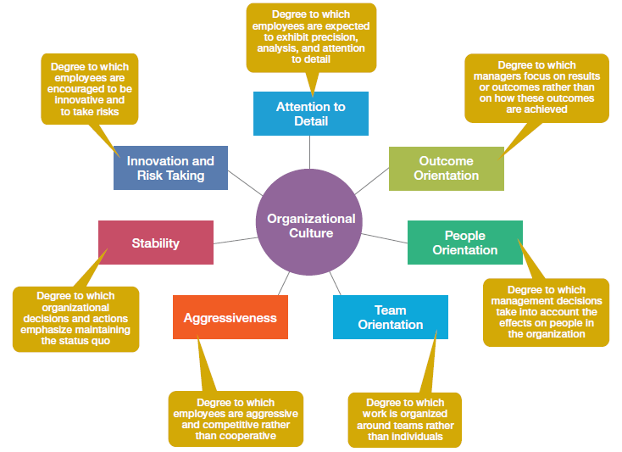
Dimensions of Culture
Copyright ©2017 Pearson Education, Inc.
2-<number>
Notes:
These seven dimensions shown in Exhibit 2-4:
• Range from low (not typical of the culture) to high (especially typical of the culture).
• Provide a composite picture of the organization’s culture.
• May emphasize one cultural dimension more than the others, essentially shaping the organization’s personality and the way organizational members work.
—Apple’s focus is product innovation (innovation and risk taking). The company “lives and breathes” new product development and employees’ work behaviors support that goal.
—Southwest Airlines has made its employees a central part of its culture (people orientation) and shows this through the way it treats them.

Slide 21
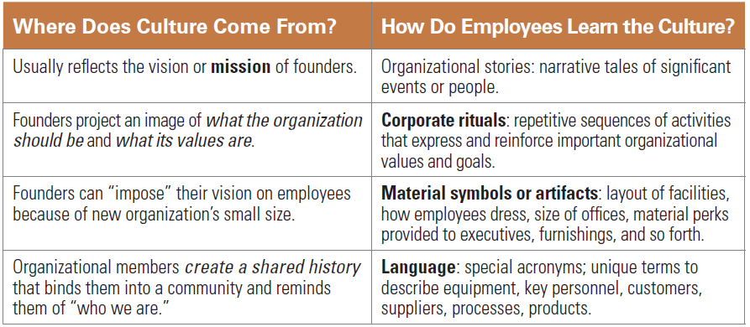
Learning Organizational Culture
Copyright ©2017 Pearson Education, Inc.
2-<number>
Notes:
An organization’s culture generally reflects the vision or mission of its founders, who establish the early culture by projecting an image of what the organization should be and what its values are.
Employees most commonly learn an organization’s culture through its stories, rituals, material symbols, and language.

Slide 22
2-4
Describe how organizational culture affects managers.
Copyright ©2017 Pearson Education, Inc.
2-<number>

Slide 23
How Does Organizational Culture Affect Managers
Effect on what employees do and how they behave
Effect on what managers do
Copyright ©2017 Pearson Education, Inc.
2-<number>
Notes:
Organizational culture affects managers in two primary ways:
Through its effect on what employees do and how they behave, and
Through its effect on what managers do as they plan, organize, lead, and control.
Ambrosia Humphrey, vice-president of talent at Hootsunite, describes how the power of organizational culture affects her as a manager. She says that a top priority for her is to nurture and nourish the company’s culture by continually creating employee experiences that reflect transparency, one of the company’s important values.

Slide 24
How Does Culture Affect What Employees Do?
Strong cultures:
cultures in which the key values are deeply held and widely shared.
Copyright ©2017 Pearson Education, Inc.
2-<number>
Notes:
The more employees accept the organization’s key values and the greater their commitment to those values, the stronger the culture is. Most organizations have moderate to strong cultures; that is, there is relatively high agreement on what’s important, what defines “good” employee behavior, what it takes to get ahead, and so forth. The stronger a culture becomes, the more it affects what employees do and the way managers plan, organize, lead, and control.

Slide 25
Strong Cultures Can:
Substitute for formal rules and regulations
Create predictability, orderliness, and consistency
Copyright ©2017 Pearson Education, Inc.
2-<number>
Notes:
The stronger an organization’s culture, the less managers need to be concerned with developing formal rules and regulations. Instead, those guides will be internalized in employees when they accept the organization’s culture.
If, on the other hand, an organization’s culture is weak—if no dominant shared values are present— its effect on employee behavior is less clear.

Slide 26
How Does Culture Affect
What Managers Do?
Say What?
Ten percent of executives say they have not identified or communicated an organizational culture.
Copyright ©2017 Pearson Education, Inc.
2-<number>
Notes:
Because an organization’s culture constrains what they can and cannot do and how they manage, it’s particularly relevant to managers. Such constraints are rarely explicit. They’re not written down. It’s unlikely they’ll even be spoken. But they’re there, and all managers quickly learn what to do and not do in their organization. For instance, you won’t find the following values written down, but each comes from a real organization:
Look busy even if you’re not.
• If you take risks and fail around here, you’ll pay dearly for it.
• Before you make a decision, run it by your boss so that he or she is never surprised.
• We make our product only as good as the competition forces us to.
• What made us successful in the past will make us successful in the future.
• If you want to get to the top here, you have to be a team player.

Slide 27
Company Values Affect Managers’ Behavior
“Ready-aim-fire” versus “Ready-fire-aim”
Copyright ©2017 Pearson Education, Inc.
2-<number>
Notes:
The link between values such as these and managerial behavior is fairly straightforward. Take, for example, a so-called “ready-aim-fire” culture. In such an organization, managers will study and analyze proposed projects endlessly before committing to them. However, in a “ready-fire-aim” culture, managers take action and then analyze what has been done.
If an organization’s culture supports the belief that profits can be increased by cost cutting and that the company’s best interests are served by achieving slow but steady increases in quarterly earnings, managers are unlikely to pursue programs that are innovative, risky, long-term, or expansionary.
In an organization whose culture conveys a basic distrust of employees, managers are more likely to use an authoritarian leadership style than a democratic one.
The culture establishes for managers appropriate and expected behavior.

Slide 28
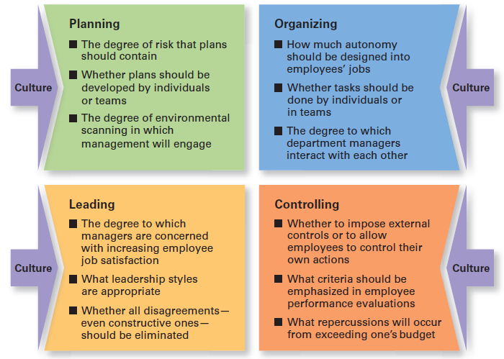
Managerial Decisions Influenced by Culture
Copyright ©2017 Pearson Education, Inc.
2-<number>
Notes:
As shown here in Exhibit 2-5, a manager’s decisions are influenced by the culture in which he or she operates. An organization’s culture, especially a strong one, influences and constrains the way managers plan, organize, lead, and control.
For example, the culture influences managerial planning about the degree of risk that plans should contain, whether plans should be developed by individuals or teams, or the amount of environmental scanning in which management will engage.
With organizing activities, culture influences how much autonomy should be designed into employees’ jobs, whether tasks should be done by individuals or in teams, and the degree to which department managers interact with each other.
When it comes to leading, organization culture helps determine the degree to which managers try to increase employee job satisfaction, appropriate leadership styles, and whether all disagreements—even constructive ones—should be eliminated.
Finally, the culture influences managers’ controlling activities: for example, whether they impose external controls or to allow employees to control their own actions, which criteria should be emphasized in employee performance evaluations, and the repercussions for exceeding one’s budget.

